Slide 1

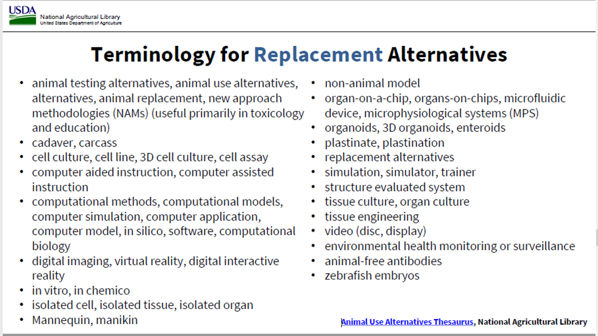
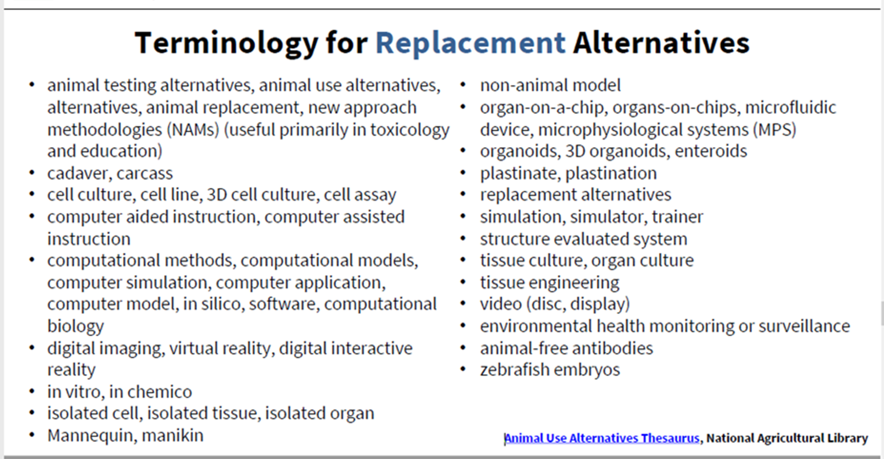
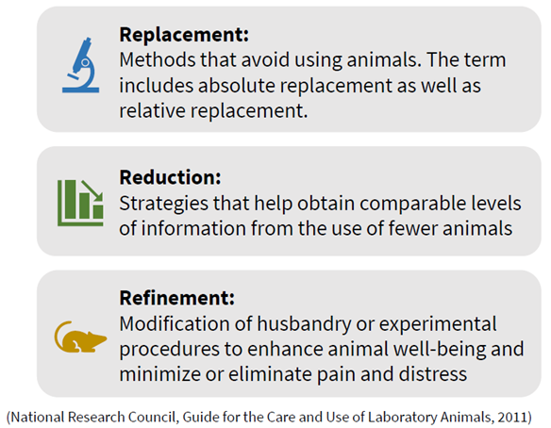

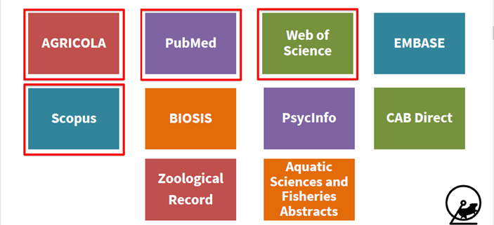
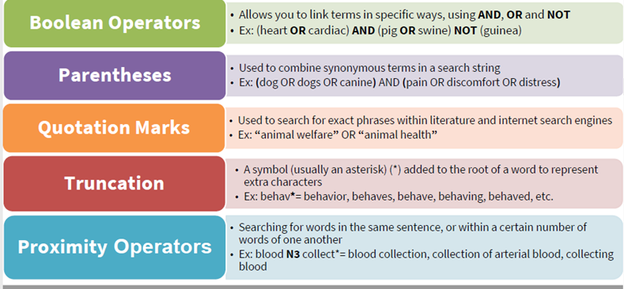


Institutional Animal Care and Use Committee
The 3 Rs ~ Replacement, Reduction, Refinement ~ Alternatives Literature Search
Conducting animal research is a privilege and can only be done when live animal models are deemed necessary.
Principal Investigator Responsibility
The alternatives search : Replacement
The alternatives search : Reduction
Consider alternatives to procedures that may cause more than momentary pain or distress to their research animals.
Provide a written narrative description of the methods and sources, e.g., the Animal Welfare Information Center, used to determine that alternatives were not available.
(iii) The principal investigator must provide the IACUC a written assurance that the activities do not unnecessarily duplicate previous experiments.
Replacement - can you use a non-animal model? Conduct a literature search to find alternatives for your research. Below are some alternatives to consider and some keywords for your literature search.
Reduction - Can you reduce the number of animals in your study? Can preliminary work be done using non-animal models? Use statistical / power analyses to find optimal group sizes. Use these tools to determine minimum sample size:
· Sample Size Calculations in Animal Research
(W. W. LaMorte, BUMC)
· ClinCalc Sample Size Calculator
· Jackson Laboratories Breeding Colony Size Planning Worksheet
Tip! Conduct a search for every IR or TR. For AMEs your Literature Search must be within 6 months and must include any new procedures and/or conditions.
What are the “3 R’s”?
The alternatives search : Refinement
Refinement – minimizing pain and distress. (1) Keep your animals comfortable and pain free. Work with the CCM Veterinary Team to review your anesthetic and analgesic regimens. (2) Ensure animal well-being through the CCM Animal Enrichment program. For questions / suggestions, please contact the CCM Enrichment Program Manager (3) Conduct a literature search for each potentially painful (Category D and Category E) procedure or resulting condition that would develop during the experiment/s. As an investigator you must consider less invasive procedures and procedures that may cause less pain, stress, or distress to the animals.
1. Use more than one database
Performing the Literature Search
3. For each procedure, list the main procedure being done; for keywords, always include the species; if a particular mouse strain or swine breed is pertinent to the procedure, use that as well. If surgery is involved, add the surgical approach (laparotomy, craniotomy, vascular cutdown, etc.) as a keyword.
Examples of Literature Searches for Procedures / Conditions
Procedure: Minipump implantation; Keywords: Rats, incision*; (“Alzet pump” OR “osmotic pump”); infusion; [any agent to be delivered via pump].
Procedure: Kidney transplant; Keywords: Rats, (renal OR kidney OR nephr*); laparotomy; transplant; immunosuppression; allogenic.
Procedure: Perfusion-fixation; Keywords: Rats, Non-survival; Laparotomy; Thoracotomy; Perfusion
Procedure (condition): Acid-Base Imbalance; Keywords: Rats, acidosis, alkalosis (and any agents being used to induce acid-base imbalance).
Procedure (condition): Sepsis; Keywords: Mice, (LPS OR endotoxin), malaise, [method of inducing sepsis]
Procedure (condition): Diabetes, induced; Keywords: Rat, streptozotocin, blood glucose.
2. Use terms to ensure a wide search
Resources
USDA:
Animal Use Alternatives (3Rs) | National Agricultural Library (usda.gov)
Literature Searching: How to Find Animal Use Alternatives | National Agricultural Library (usda.gov)
MGH:
Pain Management Formularies
IACUC Contacts for Questions
CCM Contacts for Questions
Resources

